Slide 1

Personal Accidents Cover – Model Review
March 2020

Slide 2

Agenda
Business Objective
Data
Individual Model Specifications
Chewing Damage (Tyggeskade)
Disease (Sygdom)
Critical Illness (Kritisk Sygdom)
Extended Help (Udvidet hjælp)
Immediate Replacement (Strakserstatning)

Slide 3

Business Objective
Create models that provide recommendations of Accidents Products to the customers with the highest probability of purchasing them
Recommendations based on available customer data
Current default is to not offer all covers but Immediate Replacement
Covers include:
Chewing Damage (Tyggeskade)
Disease (Sygdom)
Critical Illness (Kritisk Sygdom)
Extended Help (Udvidet hjælp)
Immediate Replacement (Strakserstatning)

Slide 4
Utilized Data Set
Test Data
48,620 observations
80% of the data was randomly selected for the training data set – 38,896 observations
Remaining 20% of the data was set aside for the testing – 9,724 observations
For the validation of the models, the ten cycles of train and test datasets determination has been used (cross-validation)

Slide 5
Dataset properties

Slide 6
Dataset properties

Slide 7
Dataset properties

Slide 8
Dataset properties

Slide 9
Dataset properties

Slide 10
Model Fitting
Models Choosen
Logistic Regression for Covers – good results for binary classification
Model Steps
Data imputation where applicable
Categorical variables converted to indicator variables for each category
Cross-Validation. Training dataset size versus testing dataset is 80% to 20%

Slide 11
Variables Used in the Models
Variable | Type | Max | Min | Example
Customer Age | Continuous | 100 | 18 | 43
ZIP Code (aggregated to geographical zone) | Categorical | 0 | 19 | 5000 (61 Fyn1)
Tariff Class | Categorical | 8 | 1 | 4
Housing Type (aggregated) | Categorical | 4 | 0 | VILL
Socioeconomic Code (aggregated) | Categorical | 31 | 2 | Α3
Occupation Code | Categorical | 1810 | 1 | 20

Slide 12
Chewing Damage Cover
Predictors:
Insurer’s Age
Zip code
Aggregated Housing Type
Aggregated Tariff Code
Socio-Economic factor
Occupation code
 | Prediction
Actual | 0 | 1
0 | 2067 | 3234
1 | 619 | 2677
Metric | Test Data
F1 Score | 0,582
Sensitivity | 0.812
Specificity | 0.390
MCC | 0.212
For Probability > =0.30 = Recommended
Notes:
Recommended threshold is the overall average computed probability for the cover

Slide 13
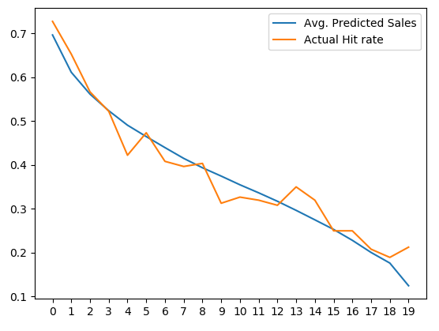
Chewing Damage Cover
 | Actual Hit rate | Avg. Predicted Sales | Max | Min
1 | 73% | 70% | 82% | 64%
2 | 65% | 61% | 64% | 58%
3 | 57% | 56% | 58% | 54%
4 | 52% | 52% | 54% | 51%
5 | 42% | 49% | 51% | 48%
6 | 47% | 46% | 48% | 45%
7 | 41% | 44% | 45% | 43%
8 | 40% | 41% | 43% | 40%
9 | 40% | 39% | 40% | 38%
10 | 31% | 37% | 38% | 36%
11 | 33% | 35% | 36% | 35%
12 | 32% | 34% | 35% | 33%
13 | 31% | 32% | 33% | 31%
14 | 35% | 30% | 31% | 29%
15 | 32% | 27% | 29% | 26%
16 | 25% | 25% | 26% | 24%
17 | 25% | 23% | 24% | 21%
18 | 21% | 20% | 21% | 19%
19 | 19% | 18% | 19% | 16%
20 | 21% | 12% | 16% | 7%
Chewing Damage Prediction Distribution
The purchase probability distribution shows (below table) that with a threshold of 0.3 will result in about 85% of the people being given the offer
High
Predicted Purchase Probabilities
Low

Slide 14
Chewing Damage Thresholds
Metrics
True Positive: Predict Yes/Actual Yes
False Negative: Predict No/Actual Yes
True Negative: Predict No/Actual No
False Positive: Predict Yes/Actual No

Slide 15


Offer Threshold
The model computes a probability for if the customer will purchase a particular cover
Threshold value is the minimum probability for offering a cover
Choice of Threshold value will impact the accuracy of the model
Higher Threshold results in a lower number of offers and more false negative
Lower Threshold results in a higher number of offers and more false positives
Lower Threshold values can help counteract ”spiral down” situations

Slide 16
Other models tested
 | Prediction
Actual | 0 | 1
0 | 2655 | 2684
1 | 933 | 2325
Multilayer Perceptron
Predictors:
Insurer’s Age
Zip code
Aggregated Housing Type
Aggregated Tariff Code
Socio-Economic factor
Occupation code
Metric | Test Data
F1 Score | 0.562
Sensitivity | 0.714
Specificity | 0.497
MCC | 0.207
For Probability > =0.30 = Recommended

Slide 17
Chewing Damage Thresholds
Metrics
True Positive: Predict Yes/Actual Yes
False Negative: Predict No/Actual Yes
True Negative: Predict No/Actual No
False Positive: Predict Yes/Actual No

Slide 18
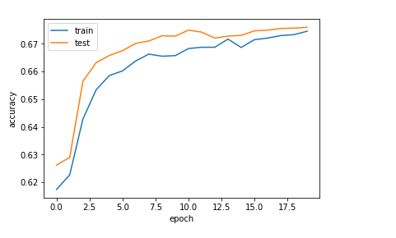
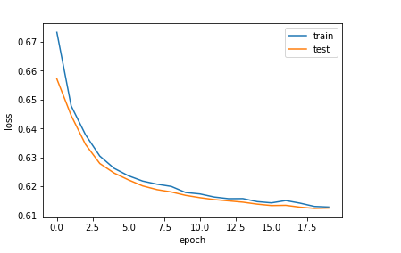
Other models tested
A plot of accuracy on the training and validation datasets over training epochs.
Recurrent Neural Networks
The maximum value we get on the validation set is 67.35%.
From the plot of accuracy, we can see that the model could probably be trained a little more as the trend for accuracy on both datasets is still rising for the last few epochs
From the plot of loss, we can see that the model has comparable performance on both train and validation datasets. From this plot we can see if there is overfitting. In this case seems to be a good fit.
A plot of loss on the training and validation datasets over training epochs.

Slide 19
Summary
The models and the main parameters that we have used in order to produce reliable results are as following:
Chewing Damage
Binary Logistic Regression
Threshold = 0.3
Multilayer Perceptions
Recurrent Neural Networks
We conclude that the results of logistic regression are approximately the same as in Rnn. So, we choose the simplest model (this mindset exists in all companies) which is Logistic Regression.

